Slide 1
Reflection
Computational thinking

Slide 2
thinking back and evaluating

Slide 3
Purpose of reflection
Identify strengths and weaknesses
Derive lessons and improve solutions
Develop long-term computational thinking skills

Slide 4
Principles of Reflection
Self-assessment
Review the entire problem-solving process
Evaluate effectiveness, efficiency, correctness, and creativity
Feedback Integration
Use evaluation results to improve solutions
Reflection supports a continuous learning loop: Reflect → Refine → Reimplement
Meta-cognition
Awareness of how you think, analyze, and solve problems
Helps extract general strategies, reusable patterns, and best practices

Slide 5
Methods (1)
Review / Retrospective
Compare the solution with the original requirements
Examine key decisions, algorithm choices, and representations
Error Analysis / Debugging Reflection
Review errors, bugs, or failures in algorithms, decomposition, or simulations
Identify root causes
Performance & Efficiency Reflection
Compare runtime, memory usage, and algorithm complexity against optimal solutions
Consider trade-offs between accuracy and efficiency

Slide 6
Methods (2)
4. Strategy Reflection
Examine approaches: decomposition, abstraction, representation
Ask: Is there a better way?
Identify patterns that can be reused in other problems
5. Documentation & Journaling
Record lessons learned, flows, decisions, and encountered challenges
Build a “knowledge base” for future reference

Slide 7
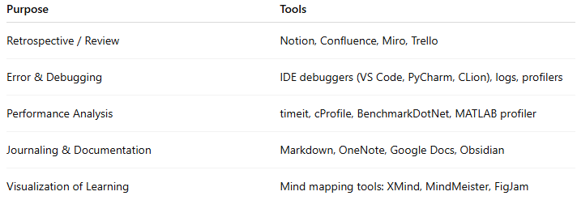
Tools

Slide 8
Common Issues

Slide 9
1. Skipping Reflection Entirely
Finish the problem → submit/close the laptop → never look back.
No lessons learned, same mistakes repeated forever.

Slide 10
2. Superficial Reflection (“It works, done”)
Never analyzing why one solution was better/worse, or realizing you over-engineered or under-engineered the problem.

Slide 11
3. Focusing Only on Correctness, Ignoring the Process
“Got Accepted 100/100” → satisfied, but blind to the fact that your O(n²) solution barely passed while an O(n) or O(n log n) existed

Slide 12
4. Not Keeping a Learning Log / Journal
After 3–6 months you forget what mistakes you made and what tricks you discovered → zero long-term improvement.

Slide 13
5. Confirmation Bias in Reflection
Only remembering what you did right and excusing or ignoring big mistakes (“the problem was tricky”, “I was running out of time”).

Slide 14
6. Never Comparing with Others’ Solutions
Skipping editorials and top coders’ code → no idea where you stand or what elegant ideas you missed.

Slide 15
7. Vague, Non-Quantitative Reflection
“My code felt a bit slow” instead of “My code was 15× slower because I used string concatenation in a loop”.

Slide 16
8. Failing to Answer the Core Reflection Questions
- If I could redo it, what would I change?
- What was my dumbest mistake?
- Which pattern/abstraction did I miss?
- Was there a much simpler way?

Slide 17
9. Reflecting Only Once, Immediately After Finishing
Reviewing again after a day or a week (when your mind is “cold”) usually reveals many more issues.

Slide 18
10. Reflection Without Concrete Action Items
Writing “next time I’ll be more careful” but never creating checklists or deliberately practicing weak areas (e.g., always write brute-force first, always test n=0, n=1).

Slide 19
11. Confusing Reflection with Negative Self-Criticism
Beating yourself up (“I’m so stupid”) → demotivation instead of constructive, positive lessons.

Slide 20
12. “Nice Guy” Reflection in Team Settings
Code reviews where everyone only praises each other and nobody points out real problems → the whole team stagnates.

Slide 21
Checklist
1. How much time did I spend on each stage (decomposition, design, coding, debugging)?
2. What was my most serious mistake?
3. If I redo it, what would I change in strategy/abstraction/implementation?
4. Did I miss a simpler or more elegant solution?
5. What specific takeaway do I have? (e.g., “always use long long in C++”, “always draw the segment tree before coding”)
6. Which skill will I deliberately practice next week based on this?

